Slide 1
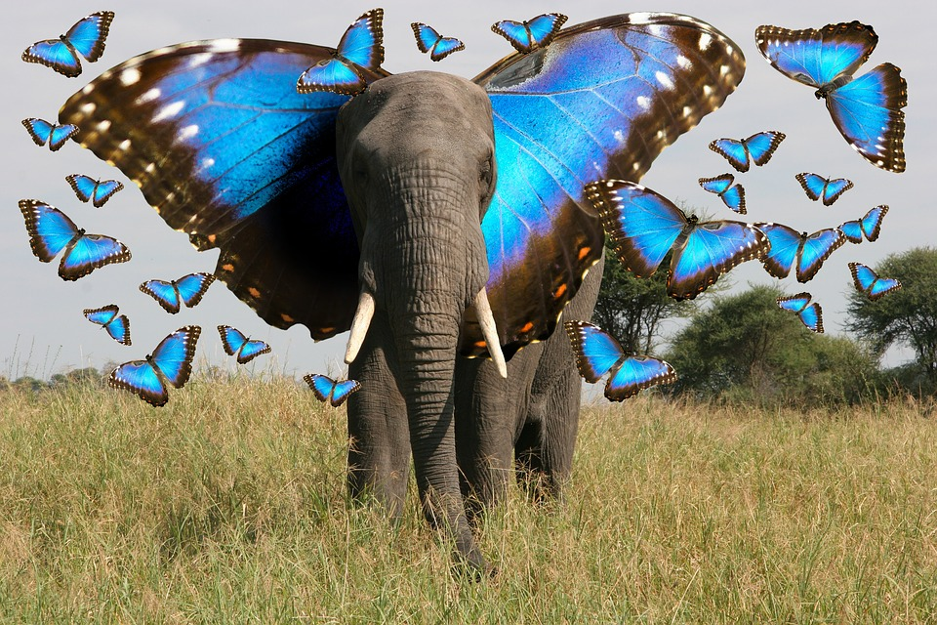
Vicente and Iftekher’s Animal Image Classifier

Slide 2
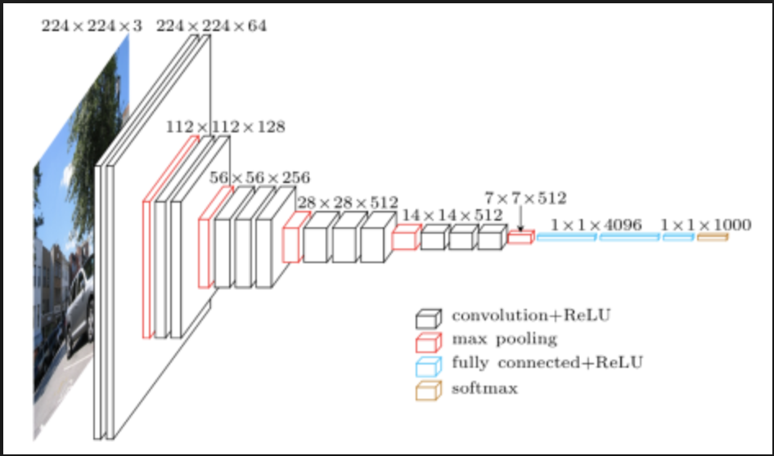
What, How, and Why?
Classify multiple different types of animals using convolution image classifier
Use Visual Geometry Group- VGG16- model and transfer learning
A pre-trained model on ImageNet
Help identify animal pictures taken by Wildlife Conservatory
Identify potential new species as well as endangered species

Slide 3
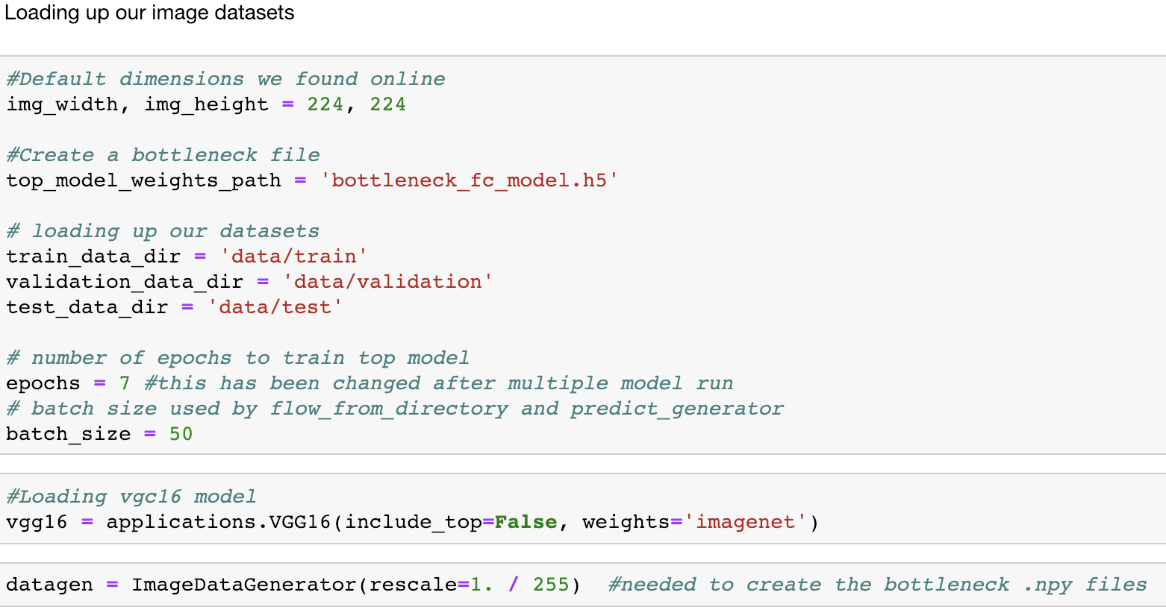

Slide 4
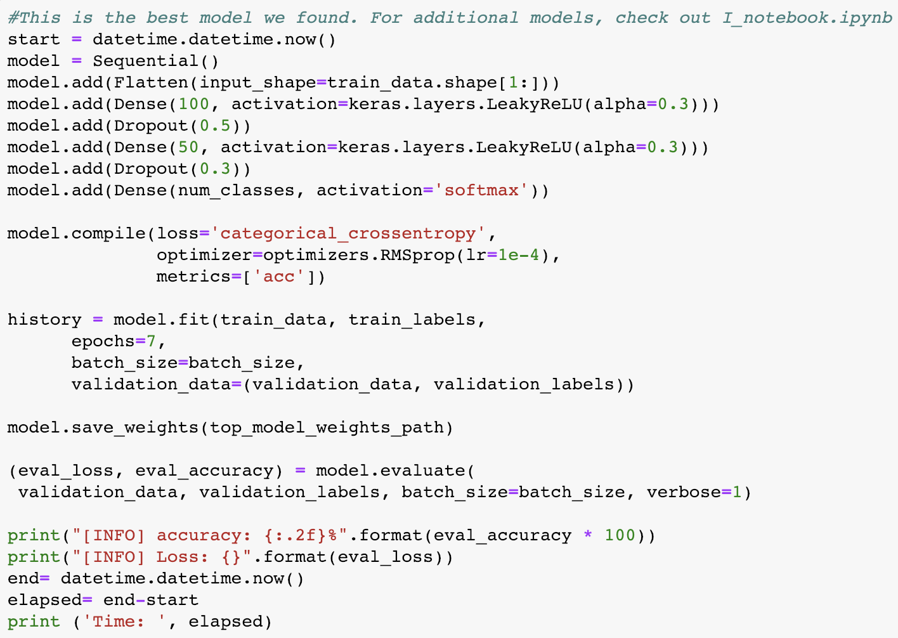
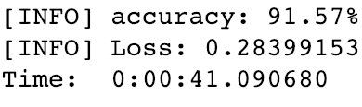
Training the Final Model

Slide 5
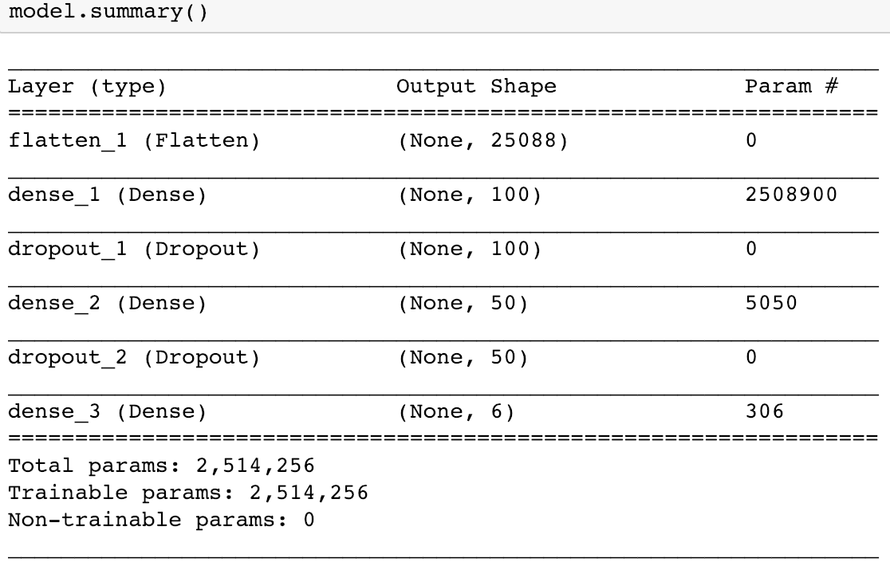
Our Best Model’s Summary

Slide 6
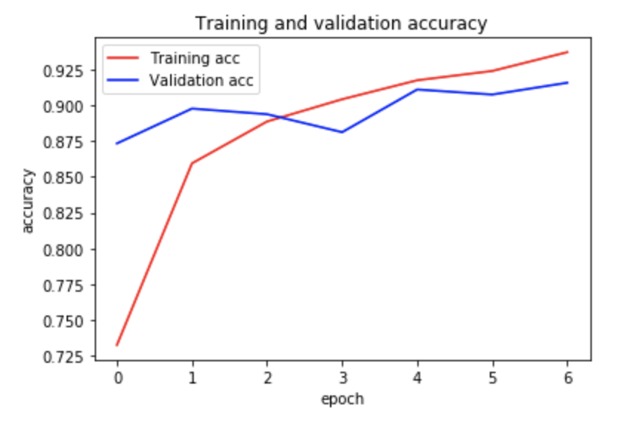
Training and Validation: Accuracy

Slide 7
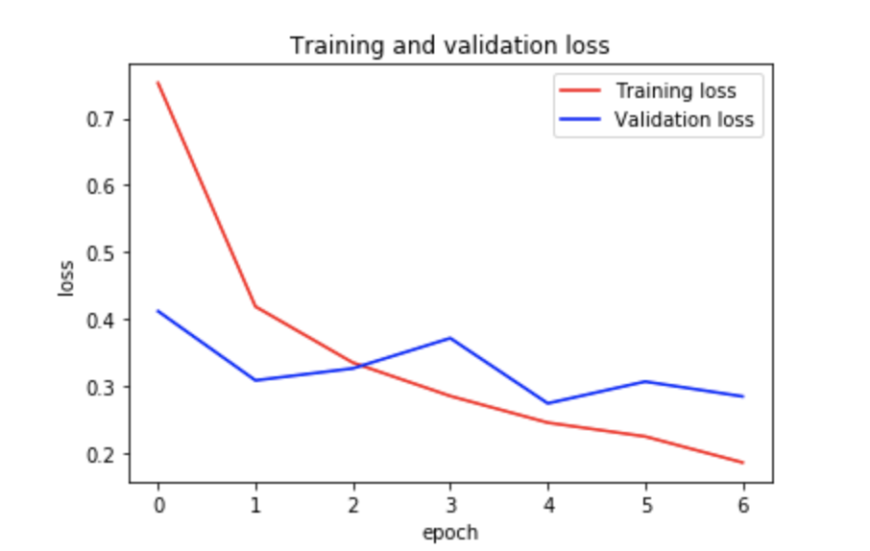
Training and Validation: Loss

Slide 8
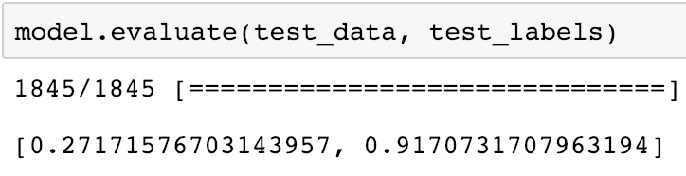
Evaluating Our Model on the Unseen Testing Set

Slide 9
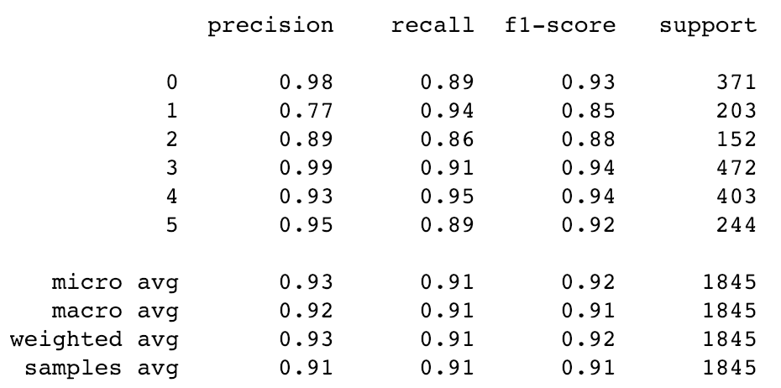
Classification Metrics
Butterflies:
Chickens:
Elephants:
Horses:
Spiders:
Squirrells:

Slide 10
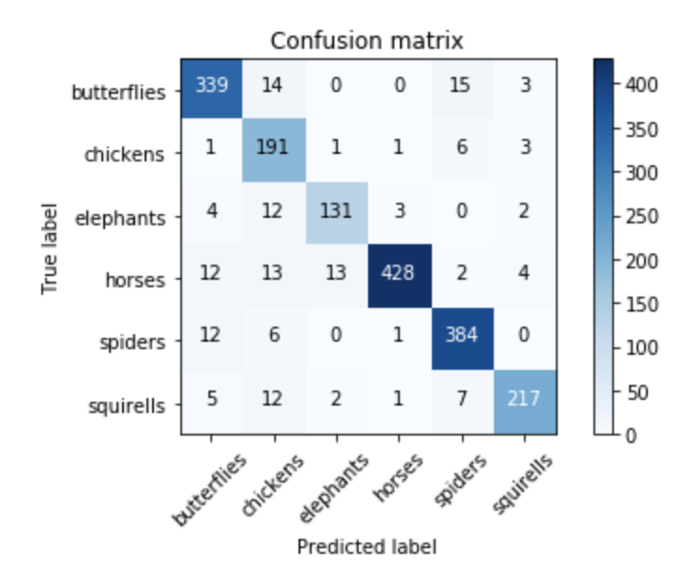
Confusion Matrix

Slide 11
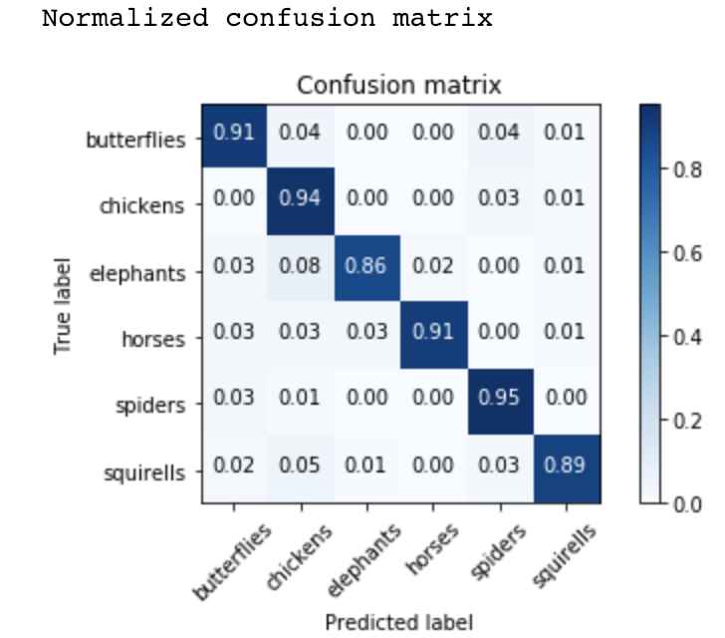
Confusion Matrix with Normalization

Slide 12
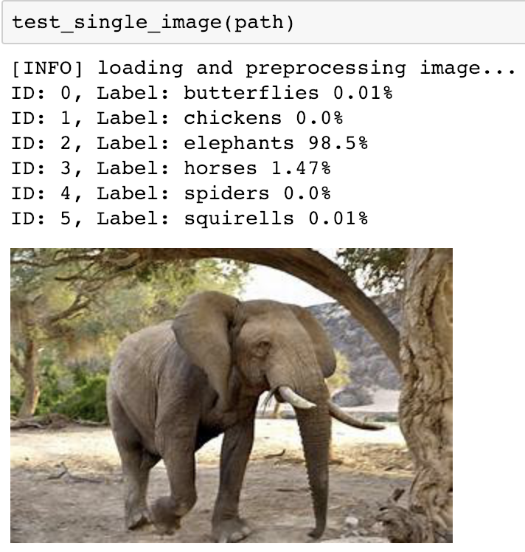
Let’s check prediction of Picture

Slide 13
Thank you!!
Let’s do some live coding in our jupyter notebook
Any pictures you want to try out?

